Slide 1
The New Jersey Department of Children and Families
Children’s System of Care

Slide 2
The New Jersey Department of Children and Families
(DCF)
Partnership for Children
The Department of Children and Families (DCF) is building one doorway for families to access services.
The doorway is called Partnership for Children

Slide 3
State System of Care
DCF
CSC
PerformCare
Mobile Response
Care Management Organization
Family Support Organization

Slide 4

Contracted Systems Administrator (CSA)
PerformCare
First Step for accessing services
Referrals and Information
1-877-652-7624

Slide 5
Crisis Mobile Response
Stabilization Services
CMRSS
On Call Mobile Response for families in crisis
Trained Intervention workers
Stabilization services
1-877-652-7624

Slide 6
Hudson Partnership
Moderate Level/High Level
Short-Term, Face-to-Face case management
In-Home Services
Service Coordination
Community Based
Intensive, long term, team based care management
Community Based
Child-Family team
Focus on Family Strengths & Needs

Slide 7
Strengths as Strategies
Focus on strengths and needs
Not family deficit centered
Identify & Incorporate Community and Natural/Informal Resources
Strategies made as a team
with and for the family unit
using the Wraparound concept

Slide 8
Wraparound IS . . .
not a program
or
a service
. . . a process
and an approach.
The Wraparound Process is as simple as people helping people
Notes:
8

Slide 9
What Wraparound Is and Isn’t
IS…A way to organize approaches
  NOT…A New Source to get transportation, money or “stuff”
IS…A philosophy of care & response impacting direct service, supervisory and policy levels
  NOT…Only for a small group of kids, Family Therapy or Case Management
IS…A process which leads to good outcomes
  NOT…An intervention or specific program
IS…A Formal incorporation of family access voice and choice at all junctures
Is…Family Centered & Hard work for everyone

Slide 10
Family Centered
Families having access, voice and choice at every stage of the planning process

Slide 11
Hudson County System of Care
FAMILY
CSC
Courts/ Probation
CIACC
Community Programs
Faith Based
Outpatient Providers
In-Home Providers
Schools

Slide 12
Practice Paradigm
Professional centered
Family centered
Experts determine needs
Families identify needs
Families as deficits
Families as capable
Service aimed at correcting
deficit
Service aimed at strengthening
families
Fit family to professional
service
Tailor service to uniqueness
Low level of family
decision making
High level of family decision
making
Focus on removing problems
Focus on enhancing competencies
Relatively fixed roles and
service provision
Flexible roles and service
provision

Slide 13
Having and Building a
Support System
An Emotional Support Plan In Home and In Community for the Family

Slide 14

Formal Services
Local Mental Heath Providers
Behavioral Assistance
In Community Services
Family Centered
Culturally Competent
Coordinated Services
Out Patient Services

Slide 15
Natural / Informal Supports and Community Resources
Friends, Family, Peers
Place of Worship
Civic & Ethnic Organizations
Community Support Groups
Neighborhood Resources i.e.; Boys/Girls clubs, YMCA, Big Brothers/Big Sisters

Slide 16
Enrichment Program
Community Workshops
Volunteering
Supporting community based programs

Slide 17
Workshops, Activities and Education
Mental Health
Substance Abuse
Child Care
Money Management
Tutoring
Child, Physical and Sexual Abuse
Immigration
Domestic Violence
Adjusting to a new country
Juvenile Justice
Crime
Parenting

Slide 18
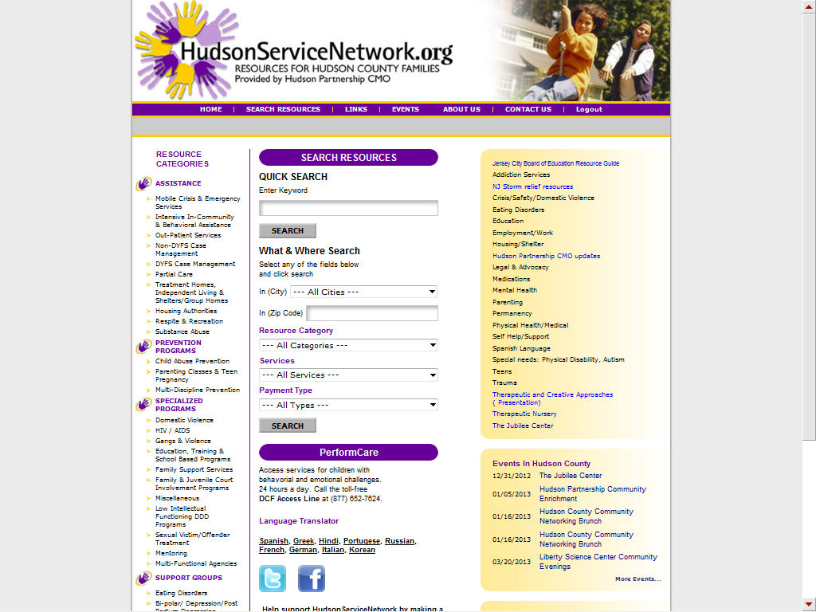

Slide 19

Family Support Organization
(FSO)
Non-Profit
Parent-Peer Support
Support Groups
Warm Line
Education
Training
Advocacy
Youth Partnership
Website:
www.njalliance-fso.org
201-915-5140

Slide 20
Benefits of the FSO
Same training courses as CMO workers
Understanding- we have a child with emotional, behavioral, mental and/or physical health challenges
Knowledgeable across Multiple Systems
Wraparound and support the family
Empower the family with support, education and advocacy training
We Travel, serving ALL of Hudson County
We can accept outside or self referrals (Warm Line)
Support the Youth Partnership of Hudson County

Slide 21
Our Mission
Working in partnership with families, children and other professionals to identify strengths, needs and appropriate resources, as well as providing community-based family support, education and advocacy for families that have children with emotional, behavioral or mental health challenges.

Slide 22
FSO Family Wraparound Plan
Family/Child
Family Support
Support Groups
Education
Advocacy
Training
Volunteer

Slide 23

FSO Youth Partnership of
Hudson County
Youth Advocacy
Voluntary Membership
Educating the Community about Mental Health Issues
Run for Youth by Youth ages 13-18
Peer Support
201-915-5140

Slide 24
Contact Us
Perform Care 1-877-652-7624
  Mobile Response
  Youth Case Management
  Hudson Partnership CMO - 201 537 1429 Steven Campos
NJA of Family Support Organizations &
Youth Partnership of Hudson County
201-915-5140

